Slide 1
Autonomous grass-cutting robot with obstacle avoidance and remote Controlling
R.V.B. Sansindi
D/ENG/23/0152/MC
STREAM : MC
Final Presentation of Individual Mechatronic Design Project

Slide 2
Content of the Presentation
Introduction
Aim
Objectives
Literature Review
Methodology
Mechanical Design
Simulations & Calculations
Testing & Validation
Budget
References

Slide 3
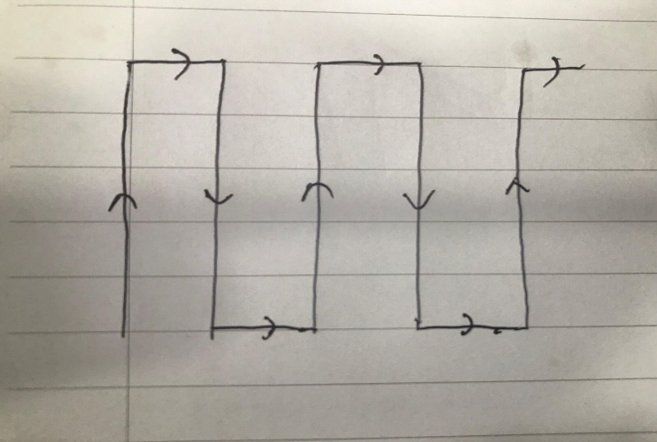
Introduction
This project is about a small-scale lawn mower.
Works in automated mode and in manual mode.
In automated mode, the robot can cut grass on the given area (area- square. Length(x) and width(y) are known and can be edited).
In manual mode, the robot can be controlled manually.

Slide 4
Aim of the Project
To design a low-cost, autonomous grass cutting robot with manual controlling with IoT based controlling and monitoring capability.

Slide 5
Objectives
Track distances accurately using the stepper motors.
Obtain direction stabilization and slipping detection using MPU sensors.
Control and monitor remotely through the Blynk application.

Slide 6
Literature Review
Robot | Control & Communication | Features | Loopholes / Limitations
Dual-Mode Grass Cutter Robot (Che Man [2]) | Wireless PS2 controller + PS2 Bluetooth receiver | Automated & manual modes | • Expensive controller • No speed control • No fully automated alignment • Cannot perform precise alignments. • No method to measure distances.
Smart Solar Agriculture Grass Cutting Robot (F. Jemisha [4]) | NodeMCU + Arduino Uno; Wi-Fi + HC-05 Bluetooth | Coordinates tracking; Blynk app communication | • Network-dependent • No speed control • No fully automated alignment • Cannot perform precise alignments
Solar Power Based Agriculture Robot (Bysani Sai Yaswanth [1]) | IoT + Android app control | Pesticide spraying, grass cutting, seed sowing | • Complex operation • No speed control • No fully automated alignment • Cannot perform precise alignments

Slide 7
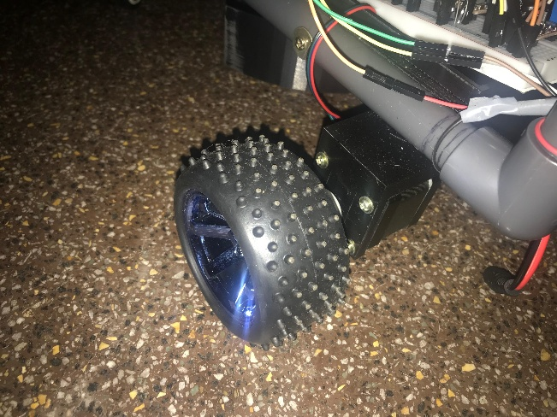
Methodology
Stepper motors are used to track the distance traveled
i.e. 200 steps per revolution,
Distance travels per a revolution = Pi * D ; D= 8cm
= 25.132 cm
Steps should be given to move =200/25.132 * L
L cm

Slide 8
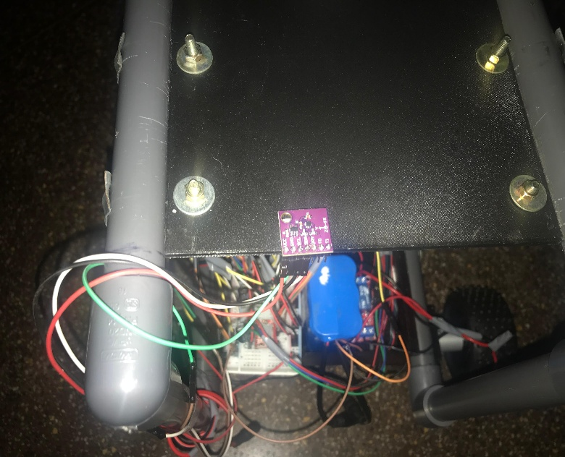
Methodology
A magnetometer module was used to keep track of the direction heading.
Without some components (before adding the DC motor, PWM motor controller, and relay), it worked as needed.
Due to the added noise, even with filters (libraries), it was not possible to eliminate the noise.

Slide 9
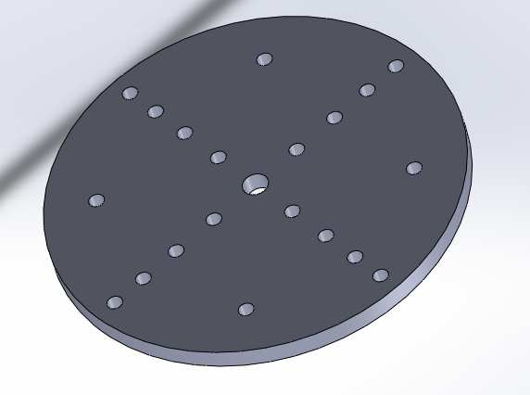
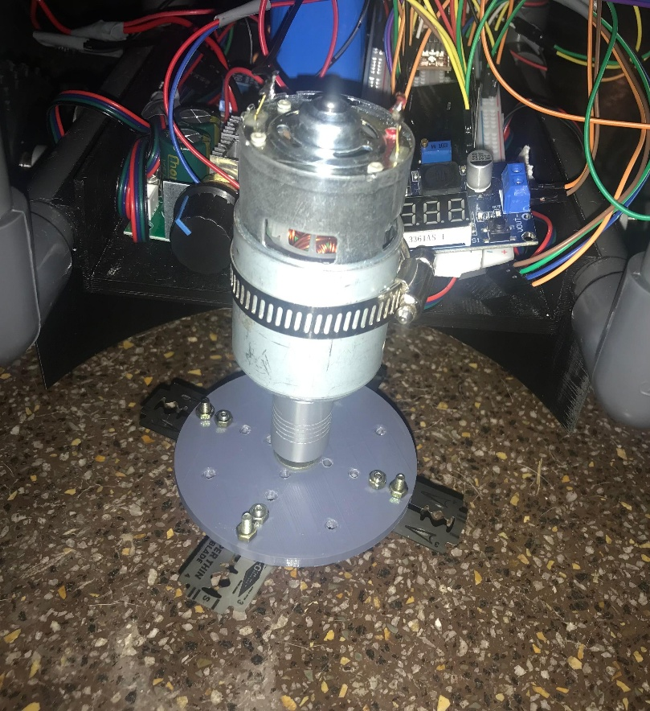
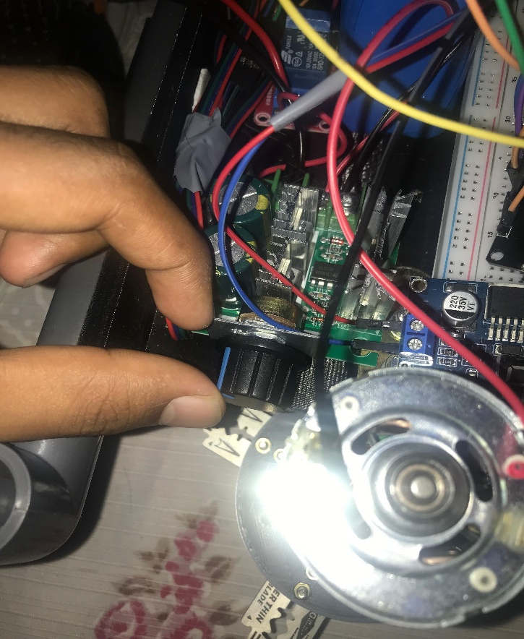
Methodology
A 3500 RPM, 12V high-torque knife motor was used to cut grass. To prevent overcurrent in the circuit, a PWM speed controller module (12V, 10A) was added to limit the power supplied to the motor and to control its speed.

Slide 10
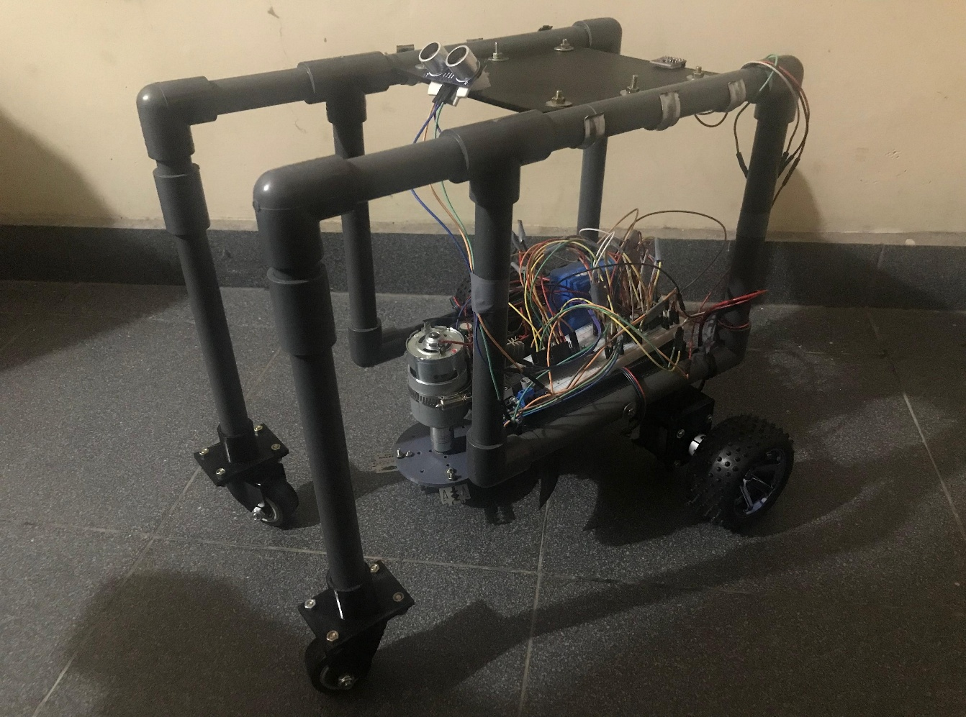
Methodology
Ultrasonic sensor was used for the object detection.

Slide 11
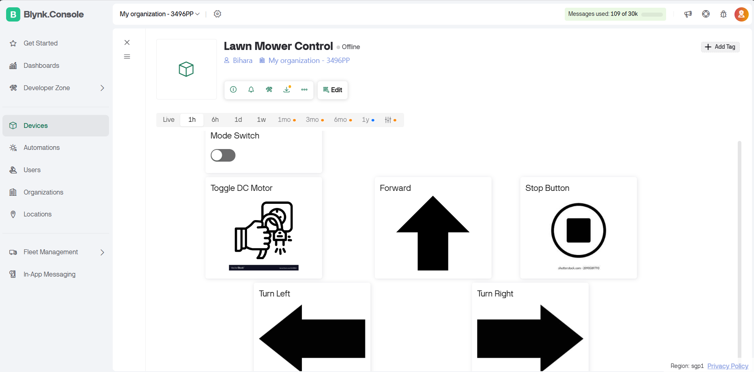
Methodology
Control panel of the lawn mower.

Slide 12
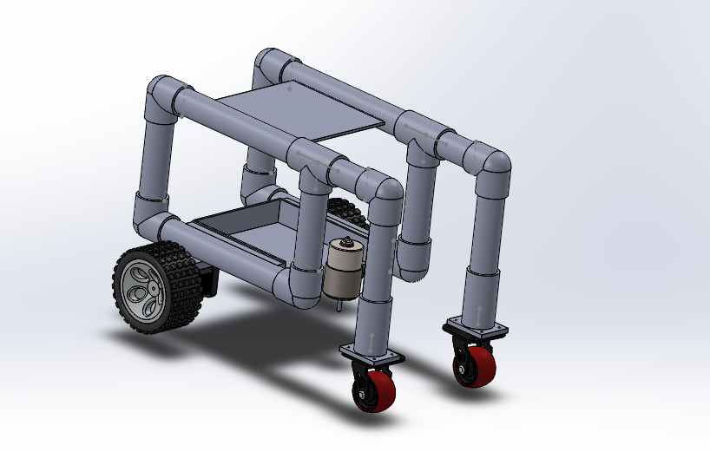
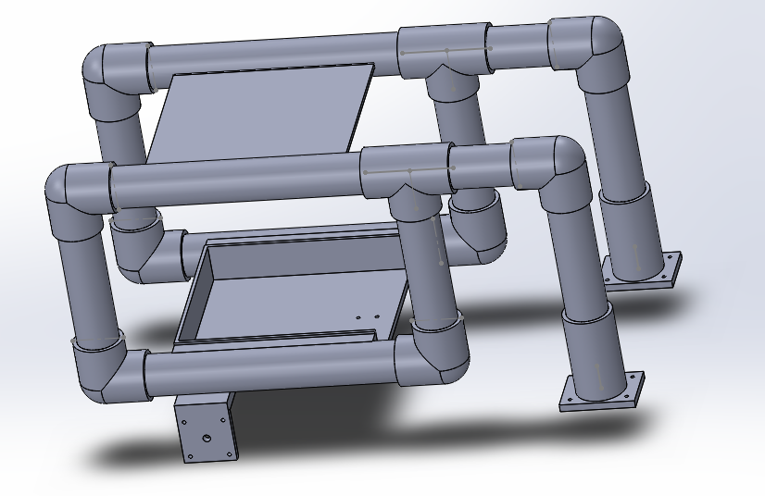
Mechanical Design chassis

Slide 13
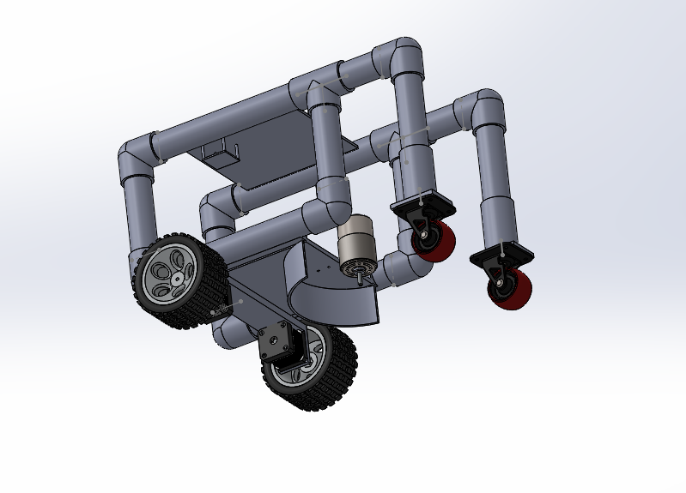
Mechanical Design chassis

Slide 14
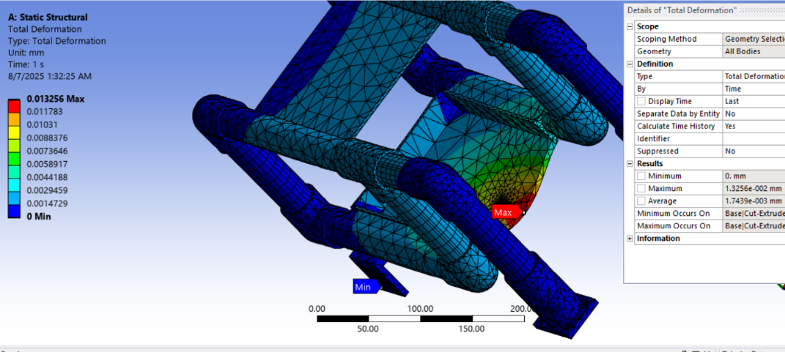
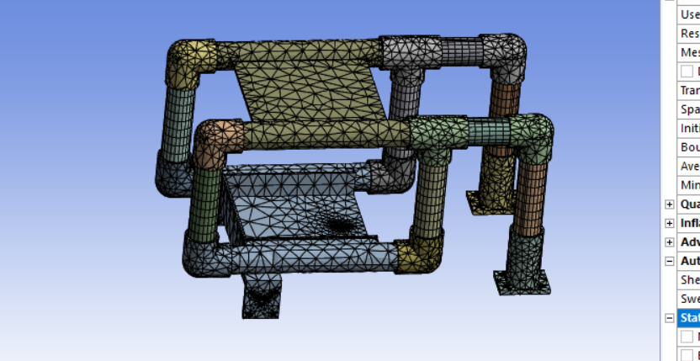
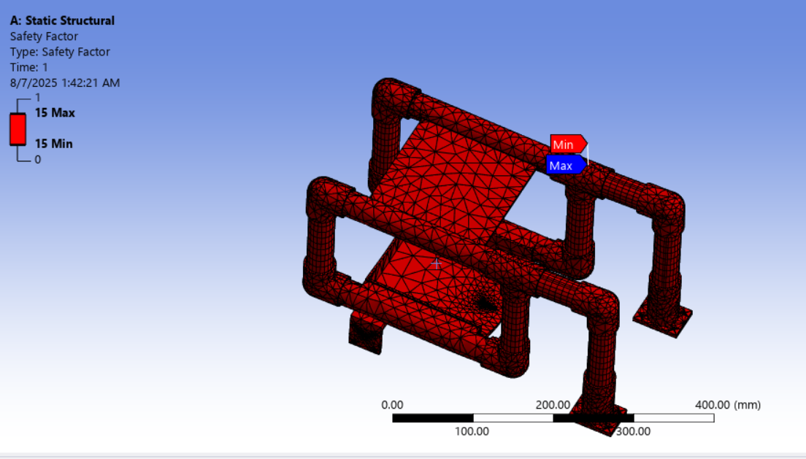
Simulations
FEA

Slide 15
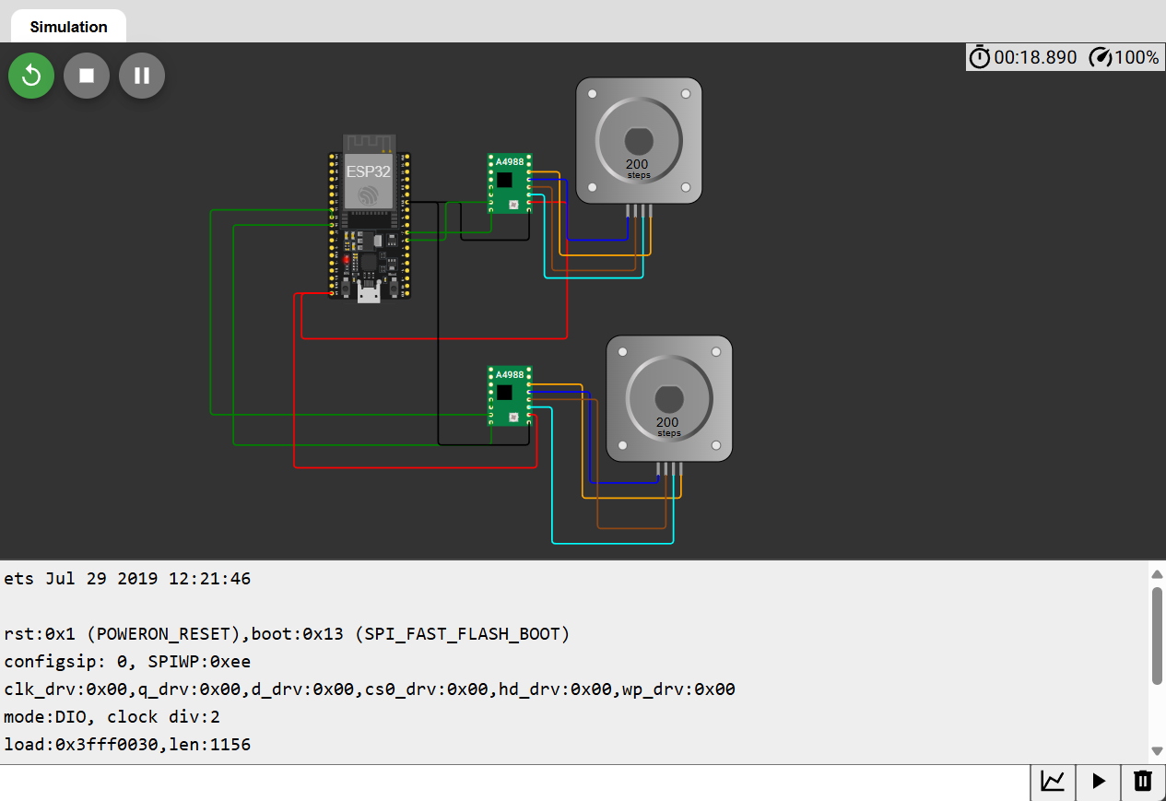

Simulations
For stepper Motor Control
Speed adjustment, direction control, rotation control of NEMA 17 motors using ESP32 was simulated.

Slide 16
Calculations
ESP WROOM 32+ Magnetometer+ 2x NEMA 17 + 12V DC Motor+ 12V Battery pack+ Caster Wheels+ Chassis+ Relay module + PWM Controller + Ultrasonic + Buck module (LM 2596)+ Miscellaneous
= 10g+ 5g+ 280gx2+ 350g+ 250g+ 300g+ 700g+ 15g + 80g + 10g +25g + 400g ;[7]
= 2.575kg +0.18 kg=2.755 kg
W=mg= 27.02655 N
F per wheel= 27.027/2= 13.515 N ;Assuming equal wheel distribution.
Torque per wheel= F x R
= 13.515 x 0.08
= 1.0812 Nm ; (<0.6 x 2 = 1.2 cm) ;0.6 Nm for the stepper motor

Slide 17
Calculations
Stepper motors are used to track the distance traveled
i.e. 200 steps per revolution,
Distance travels per a revolution = Pi * D ; D= 8cm
= 25.132 cm
Steps should be given to move =200/25.132 * L
L cm

Slide 18
Calculations
With the 12V high-torque knife motor, 4 NM torque can be obtained at 3000RPM. This is adequate to provide the cutting force of 5N (Medium Condition).
Torque= Force x R ; Cutting disc diameter
= 5N X 0.4m
= 2 Nm (< 4Nm)

Slide 19
Calculations
Component | Voltage (V) | Current (A) | Power (W = V × I)
ESP32 (WROOM 32) | 3.3 V | 0.160 A | 0.53 W
2 × NEMA 17 Stepper Motors | 12 V | 2 × 1.2 A | 28.8 W
12 V DC Cutter Motor | 12 V | 3.0 A | 36.0 W
Relay Module | 5 V | 0.070 A | 0.35 W
PWM Motor Controller (logic) | 12 V | 0.010 A | 0.12 W
HC-SR04 Ultrasonic Sensor | 5 V | 0.015 A | 0.075 W
LM2596 Buck Converter (est.) | 12 V | 0.100 A | 1.20 W
Magnetometer (HMC5883) | 3.3 V | 0.100 A | 0.33 W
P (total) ​≈67.4W (<70 W))

Slide 20
Budget
Component | Price
NodeMCU ESP32 CH340 WiFi Bluetooth Dual Mode IoT Dev Board Type C | 1,200
2 × NEMA 17 Stepper Motors | 4,200
12 V DC Cutter Motor | 1,350
Relay Module | 350
PWM Motor Controller | 850
HC-SR04 Ultrasonic Sensor | 250
LM2596 Buck Converter | 500
Magnetometer (HSCDTD008A) | 650
3D Printed chassis | 5,400
Caster wheels x 2 | 1,920
Wheels x 2 | 3,000
A4988 Drivers x 2 | 500
Couplings x 3 | 1000
Other (connecting wires, Adhesives, Tools, nut and bolts, cables, pipes, etc.) | 7000
Total | 28,000

Slide 21
Testing & Validation
Initially (without DC motor, PWM controller, Relay), direction stabilization could be able to perform using the magnetometer sensor.
But with the noise added(In new setup), robot could not identify the specific directions to follow and align.
Therefore, magnetometer was not used for the final prototype.
Due to that, robot makes deviations from the path it has to follow. (weight imbalances, uneven rotations of the two wheels, battery percentage also affects this).
Distances can be inaccurate (up to 10 cm) and accuracy also depends upon the ground, battery percentage etc.
Also, when controlling the robot through Blynk Application (or website), there can be a latency. Depends upon the speed of the internet connection.

Slide 22

Final Product

Slide 23
References
[1]. Bysani Sai Yaswanth, N. Pruthvi Raj, B. P. Rahul, V. M. Moger, and T. Venkatesh, “Solar Power Based Agriculture Robot for Pesticide Spraying, Grass Cutting and Seed Sowing,” Lecture notes in electrical engineering, pp. 795–805, Jan. 2022, doi: https://doi.org/10.1007/978-981-19-2281-7_73.
[2] (PDF) development of dual-Mode Grass Cutter Robot, https://www.researchgate.net/publication/362736534_Development_of_Dual-Mode_Grass_Cutter_Robot (accessed Jun. 15, 2025).
[3]. N. Herrera and R. Luciano, “Design And Development Of Android-Controlled Grass Cutting Robot Using RPA Method.” Accessed: Jul. 31, 2025. [Online]. Available: https://ijstr.org/final-print/mar2020/Design-And-Development-Of-Android-controlled-Grass-Cutting-Robot-Using-Rpa-Method.pdf
[4] F. Jemisha, S. S. Jothi, R. S. Priyanka, and E. Ramola, “Smart Solar Agriculture Grass Cutting Robot,” Mediterranean Journal of Basic and Applied Sciences, vol. 07, no. 02, pp. 41–47, 2023, doi: https://doi.org/10.46382/mjbas.2023.7206.
[5] F. van Oudtshoorn, “Grasses and Grassland Ecology,” African Journal of Range & Forage Science, vol. 27, no. 1, pp. 63–64, Apr. 2010, doi: https://doi.org/10.2989/10220111003703542.
[6]. M. J. O’Dogherty and G. E. Gale, “Laboratory studies of the cutting of grass stems,” Journal of Agricultural Engineering Research, vol. 35, no. 2, pp. 115–129, Oct. 1986, doi: https://doi.org/10.1016/0021-8634(86)90033-8.
[7]. “Handson Technology Data Specs 17HS4401S 1.7A Torque:43N.cm Stepper Motor.” Available: https://www.handsontec.com/dataspecs/17HS4401S.pdf

